Slide 1
Credit Card default prediction

Slide 2
Objective
The Credit Card Default Prediction system is a machine learning-based solution aimed at predicting whether a customer will default on their credit card payment.
The system leverages historical data from a well-known Kaggle dataset, using various features related to customer demographics, credit history, and payment behavior to make predictions.

Slide 3
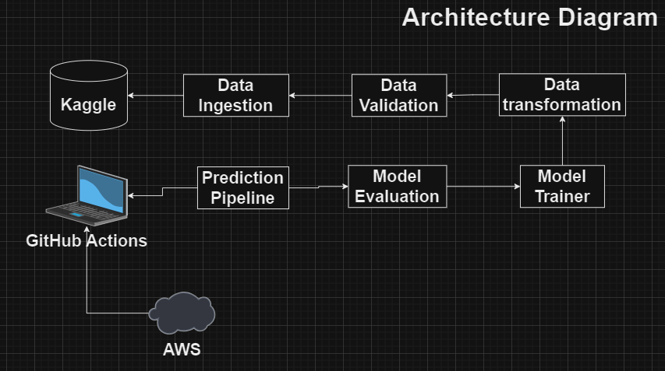
Architecture

Slide 4
Data Ingestion
Database Creation: Create a database to store raw data, preprocessed data, and predictions.
Table Creation: Tables are created in the database to store different stages of the data pipeline (raw, processed, and predictions).
Data Insertion: Insert CSV data into the database tables for further processing.

Slide 5
Data Preprocessing
Null Value Handling: Replace missing values with appropriate imputed values or drop rows/columns as necessary.
Encoding: Convert categorical variables (SEX, EDUCATION, MARRIAGE) into numerical format using one-hot encoding or label encoding.
Scaling: Normalize numerical features (LIMIT_BAL, AGE, etc.) to ensure all features contribute equally to the model.
Feature Engineering: Create new features if needed to enhance model performance.

Slide 6
Data Validation Stage
Purpose: Ensures that the ingested data meets the required quality and schema standards.
Components: Uses DataValidationConfig to encapsulate validation parameters. The validation checks against a schema defined in a YAML file and saves the status of the validation process.
Pipeline Execution: The DataValidationTrainingPipeline class handles the validation process, and its execution is managed similarly to the data ingestion stage.

Slide 7
Data Transformation Stage
Purpose: Transforms the validated data into a format suitable for model training.
Components: DataTransformationConfig holds paths and directories for transformed data storage.
Pipeline Execution: Managed by the DataTransformationPipeline class, which processes the data and saves the transformed output.

Slide 8
Model Training Stage
Purpose: Trains the machine learning model using the transformed data.
Components: ModelTrainerConfig stores configuration parameters like training data paths, model hyperparameters, and the target column.
Pipeline Execution: The ModelTrainingPipeline class executes the training process, saving the trained model and the scaler used.

Slide 9
Model Evaluation Stage
Purpose: Evaluates the trained model's performance on the test dataset.
Components: ModelEvaluationConfig contains paths for the test data, model, scaler, and evaluation metrics.
Pipeline Execution: The ModelEvaluationPipeline class handles model evaluation, outputting performance metrics.

Slide 10
Model Deployment
Model is deployed on AWS EC2 instance
Docker image was created, and it was pushed into AWS ECR
The deployment was done using Github Actions

